Slide 1
Portfolio
English 4
Ingeniería
2023-1
Prepared by María Cecilia Aguilar S.
February 2023

Slide 2
Portfolio in PIFLE
Autoevaluation
Reflection on one’s progress
Collection of evidences
10% x 3

Slide 3
Two sections
Folder in Drive with individual activities evidence
Rubric in the platform

Slide 4
1. Folder

Slide 5

Create the folder
→ Your Drive
English_4_Pedro_Suárez

Slide 6
Share the link of your e-portfolio with the tutor in
https://bit.ly/3jJO4W3
Give me access as editor/commenter →maria.aguilar@udea.edu.co

Slide 7
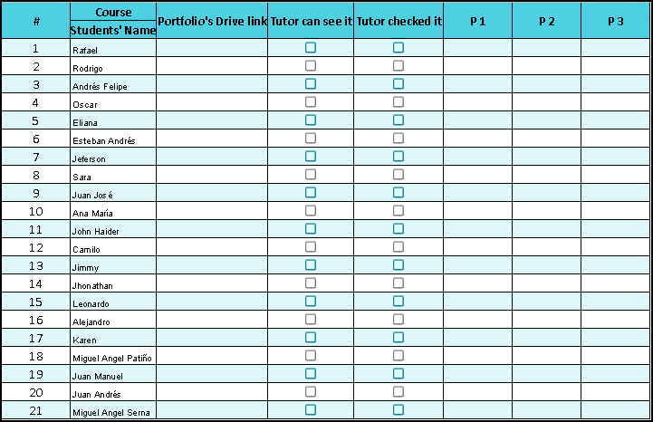

Slide 8

Include
e-Task-1
e-Task-3
e-Task-2

Slide 9

e-Task-1
Individual activities

Slide 10
Do the same in the other tasks

Slide 11
Individual activities
Screenshots with their descriptions
Word files
PDF files
Videos/audios

Slide 12
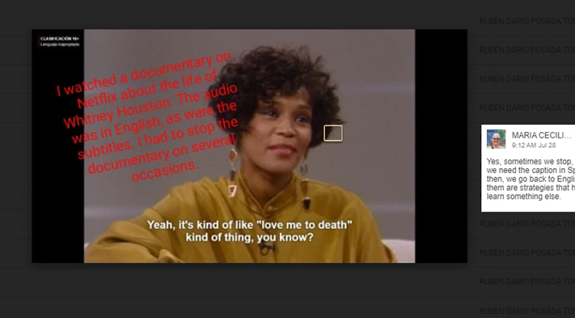

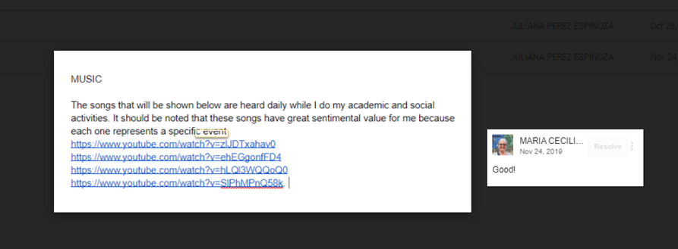
Samples

Slide 13
2. Rubric in the Platform

Slide 14
Rubric
Provided by the program
Specific for every e-Task
Complete by the deadline
If the rubric is not filled up, I won’t check the Portfolio
Feedback in the rubric and in the folder

Slide 16
Notice
For every Portfolio deadline →
If either the folder or the rubric is missing, the grade will be 0.0

Slide 17
Doubts?
Follow the instructions and the steps
Use the Questions and Doubts Forum
Fulfill the due dates

